Slide 1
Data Visualization & Interpretation
Febin.A.Vahab

Slide 2
VISUAL ANALYTICS

Slide 3
PLAN
UNDERSTANDING DESCRIPTIVE STATISTICS
REFERENCE OBJECTS
TREND LINES
BOX PLOTS
FORECASTING
CLUSTERING
SETS

Slide 4
Forecasting
Process of fitting models using historic data to predict future observations.
Exponential Smoothing

Slide 5
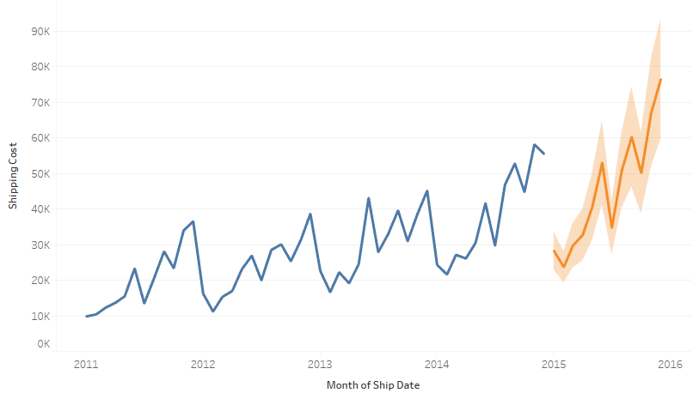
Forecasting

Slide 6
DEMO
GLOBAL SUPERSTORE DATASET
Forecast the shipping cost for global superstore products for 2015

Slide 7
CLUSTERING

Slide 8
CLUSTERING
Clustering, or cluster analysis, is the task of taking similar data objects and grouping them together, separate from other dissimilar data objects in other groups

Slide 9
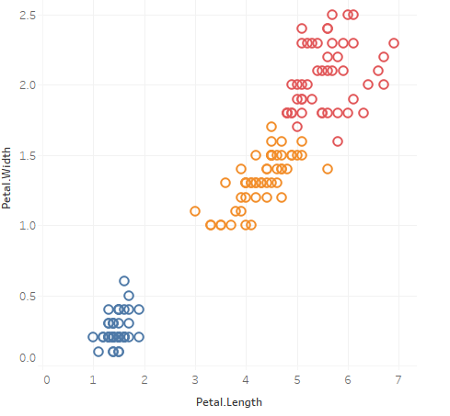
K Means-CLUSTERING

Slide 10
Tableau
Numeric values
Categorical values
Mix and match numerical and categorical values

Slide 11
Tableau
Upto 50 Clusters
Aggregate the dimensions
Categorical Data-25 unique members
Create a group from cluster results
Refit saved clusters

Slide 12
Use Cases
Exploratory analysis
Find complex relationships between several variables
Population Segmentation
Fraud and Anomaly Detection
Optimisation

Slide 13
DEMO
IRIS DATA SET

Slide 14
SETS

Slide 15
SETS
Dynamic Sets:
Based on single dimension
The members of a dynamic set change when the underlying data changes
Fixed Sets
Based on a single dimension or multiple dimensions
The members of a fixed set do not change, even if the underlying data changes.

Slide 16
DEMO
Local Manager wants to see if LATAM customers follow the general trend of orders as found with the organization as a whole.

Slide 17
Thank You!

